Slide 1
M7 Sales kit

Slide 2
STP
Segmentation
20-30 people SMB/Corp/Education user
Positioning
4000 AL Business wireless projector
Target Audience
Rich connectivity
Diversity projection way for presentation
Advanced controllability
Affordable price

Slide 3
Selling point for M7 series
Excellent meeting handling function (with QCast app)
Long lamp life* (to 15000 hrs)
Diversity way for projection (Wireless/Mirror/HDMI/Usb reader)
Control system Compatibility (with Extron/PJ Link/Crestron/AMX)
Rich connectivity (HDMI*2 +USB (Type A)*2 + USB(mini B)*1
High contrast ratio* (highest to 20000:1)

Slide 4
Why M7?

Slide 5
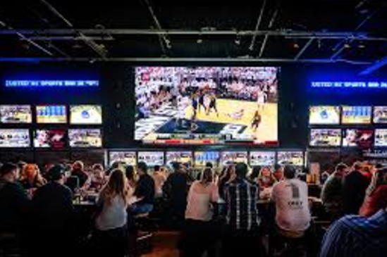
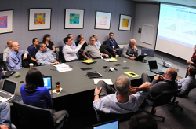
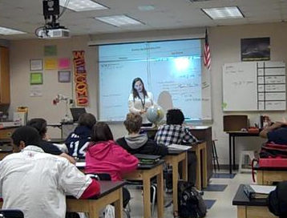
Target scenario for M7
Designed for SMB/Corp/Classroom/small commercial opening area
Used in medium-size room (20-30 people)
Notes:
medium-size meeting room (10-20 people) : the most common meeting room type for general meeting purpose

Slide 6
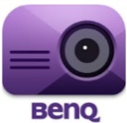
Target User
.
To user who may need
Efficient
Operation
Web page mode
(LAN Control)
15000 hrs Lamp Life
Upper Lamp door
Corner Fit
2D Keystone
User-Friendly Web Control Tool
Multiple PRJ management(MDA)
Connect with Extron/PJ Link/Crestron/AMX
Low
Maintenance Cost
Diversified
Presentation
HDMI*2+USB (typeA)*2
USB Reader
LAN Display
Wireless Display
(with QCast app)

Slide 7
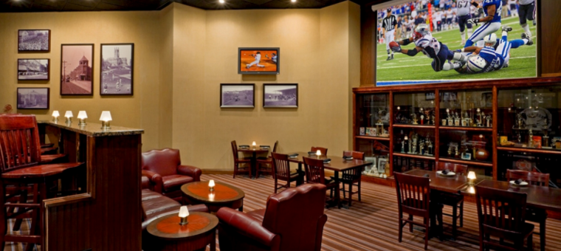
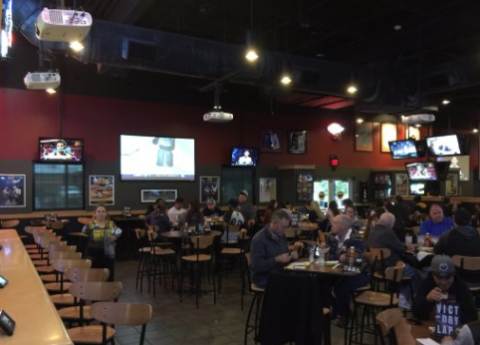
Scenario : restaurant/sports bar
What do user need:
Centralized control (on/off/volume/setting) from checkout register
Easily adjust content for Wireless display (suggest with QCast mirror)
Connect with existed Control system (Extron/PJ Link/Crestron/AMX)

Slide 8
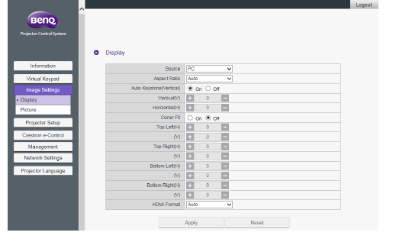
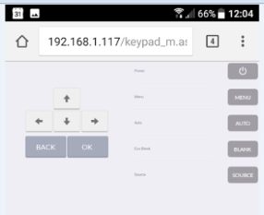
LAN control + Web page tool
  M7 has a new user-friendly OSD interface, and a more intuitive LAN control interface through Web Page Tool/APP for users to operate the projector more efficiently.
Remote Control keypad via QCast App
Web Page Tool for LAN Control

Slide 9


Control system Compatibility
AMX. Crestron, *Extron IP Link Control device compatible
No matter which brand of control system used in the meeting room, M7 could be easily integrated with companies’ existing device.
Widely compatible with leading projector control systems including Crestron, AMX, Besides, we also offer seamless support for the *Extron Control IP Link system in M7, making it simple to integrate into corporate network infrastructures

Slide 10
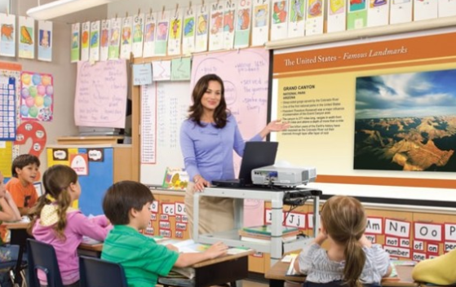
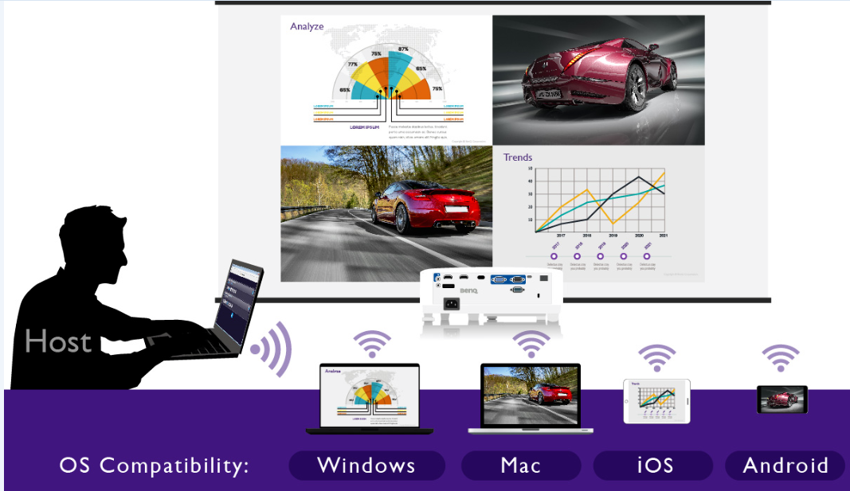
Scenario : Classroom/meeting room
What do user need:
Diversified interface for projection for all the users
(HDMI/LAN/Wireless/USB reader)
Wireless projection + web browsing at same time
Split-Screen projection and effective meeting control for the host/teacher
(Max 4 users in the multi screen)

Slide 11
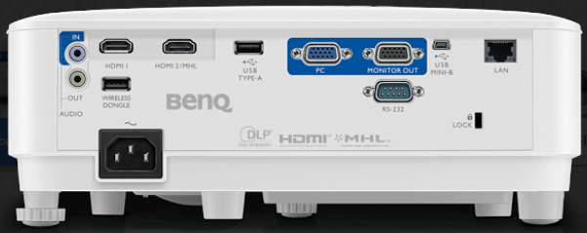
Diverse interface for projection
HDMI *2 (1 with MHL)/Wireless dongle port/USB type-A *1/USB mini B*1

Slide 12

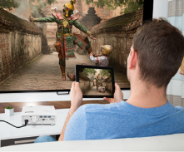
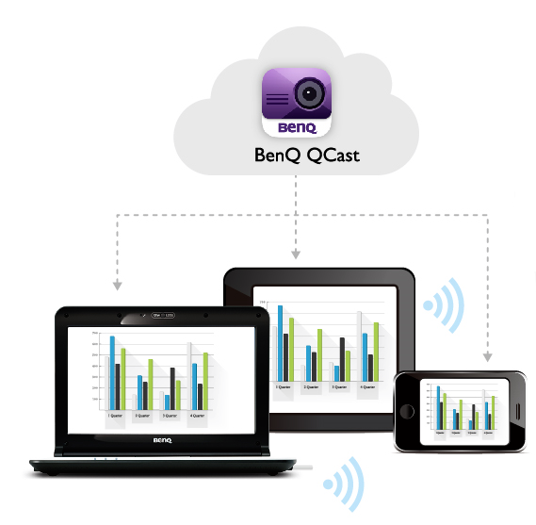


M7 Wireless Compatibility
Multiple Choice of Wireless Presentation Compatibility
Basic Wireless Projection
Insert a WDRT8192 dongle in an unique USB-A port named WIRELESS DONGLE to display various static document formats and collabrate your meeting through BenQ QCast App* from your personal device.
Easy-Sharing Projection
Insert QCastMirror dongle in HDMI1+USB TypeA port to mirror your screen of your personal device without using App!
**The device needs to support Miracast/Airplay function.

Slide 13
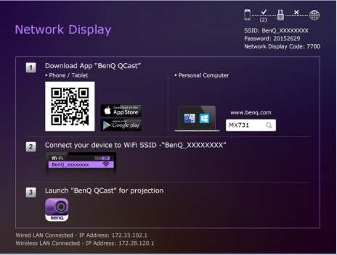
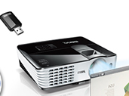
Smart Presentation via QCast App
PC/ Smart Device Projection under Wireless Environment
-Insert a WDRT8192 Wireless Dongle to the projector
-Choose “Network Display” Source
-Execute the below instruction from OSD “Network Display” Page to connect your PC/ Smart Device to the projector.
-Launch “QCast” application

Slide 14


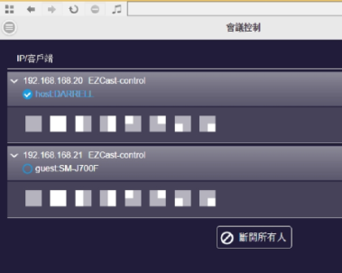


4 in 1 split-screen projection
Split-Screen Function to enable Multi-Screen Projection
Host + Conference Mechanism to collaborate your meeting
Host (First connected User) can take control of displayed content from the devices!
Up to FOUR users can project PC/Phone/Tablet image in the same time!
1. Automatically allow or deny participants to project.
2. Manually allow participants to project and assign their projection position.(Full screen or split screen)
3. Manually deny all participants to project.

Slide 15
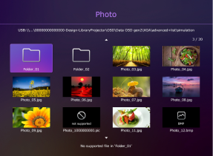
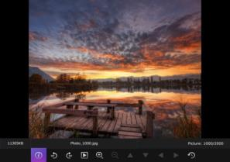
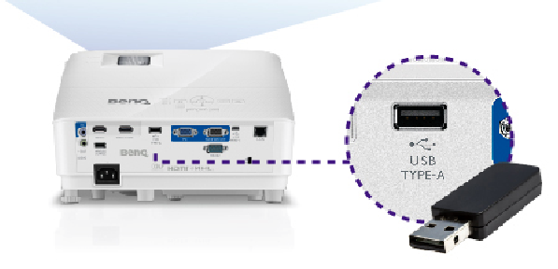

USB Reader
PC Less Presentation!
M7 has USB Reader function for users to do the presentation more efficiently ! You can display picture and document without using a laptop by just inserting USB Flash Drive in Type-A port. The supporting format includes JPEG, PDF, MS Word, MS Excel, and MS PPT!

Slide 16

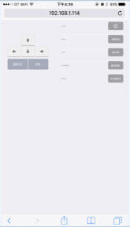
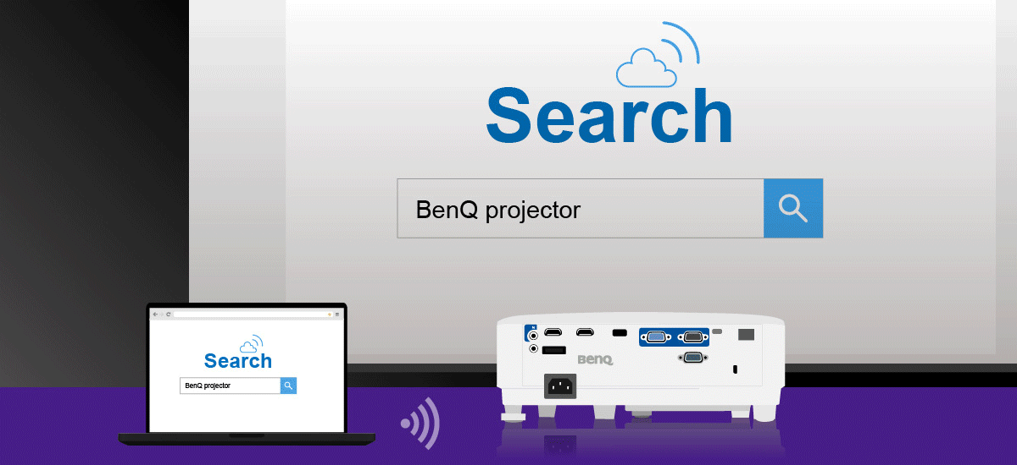
Browsing internet during WI-FI projection
Allow users to setup the External Internet.
Remote Control Function
User can use the Internet at the same time while doing the wireless display.
User can control projector remotely by using below easy-to-read buttons in App without using the physical keypad of RC or projector.
*Choose the AP hot spot/ Router and connect
*Available for iOS/ Android system

Slide 17

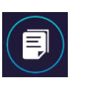




More about QCast app for your smart device
1 to 1 Projection:
1. PC Projection: Windows, MAC
2. Smart Device Projection: iOS, Android
User can display Static Document/ Photo on the projector from his smart device for commercial purpose (Not support Video)
1. Mirror Screen of user’s PC on the projector
1. Display the PPT, Word, Excel, PDF files on the projector through Document Icon
2. Extend Screen of user’s PC on the projector
*Windows 10 is not support
2. Display the pictures on the projector
through Photo Icon
3. User can determine whether to open Audio function.
3. For some Android device (Android 5.0 above), user can mirror his screen on the projector.
*Default Audio: Off, the audio performance is not good when the resolution of projected content is above 720p
*Not support Audio
Supported OS | Windows/MAC
 | Windows 7~10
 | MAC OS 10.11~10.12
Supported OS | IOS/Android
 | iOS 9~10
 | Android 5.0 above

Slide 18
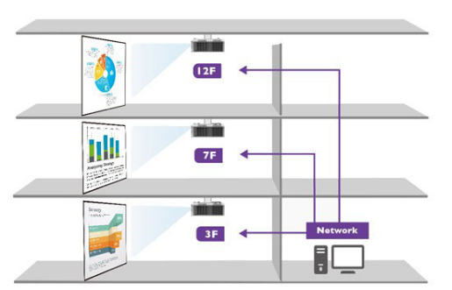
Use LAN Control from IT room
LAN Control Centralized Projector Management
LAN Control is designed to help IT managers perform day-to-day projector maintenance and repair tasks efficiently and effectively – offering them full access and control over every projector directly from their workstations. M7 also supports RS-232 for reliable long-distance Installations, up to 15 meters, for situations without LAN infrastructure.
Save company maintenance cost!

Slide 19
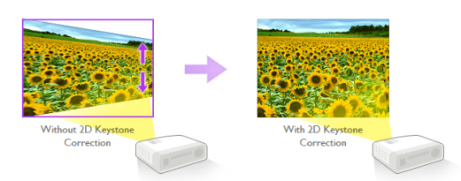
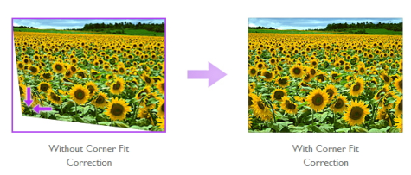
2D Keystone / Corner Fit
When the projector is placed off center, the 2D keystone correction feature gives you wider projector installation flexibility by correcting the trapezoid effect using horizontal and vertical adjustments.
Corner Fit is a flexible and convenient way to correct picture dimensions by adjusting each corner of an image independently.

Slide 20
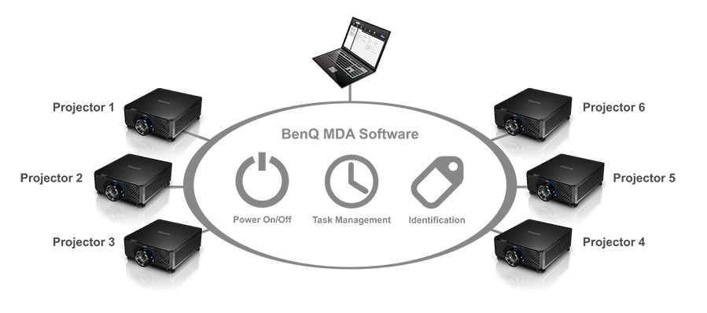
Multiple PRJ management with MDA
BenQ Multiple Display Administrator (MDA) software dashboard enables projector control, identification and task management from a single computer. MDA can simplify routines such as opening and closing procedures with scheduling features and by allowing remote power on and off.
**Picture: TBD

Slide 21

Long lamp life
The longest lamp life among 4000 lm projector.
LampSave mode helps to save up to 70% lamp power consumption depending on the content brightness level and keeps the image as bright as it is in normal mode.
15000
Maximum
No more compromise between image quality and power consumption!

Slide 22
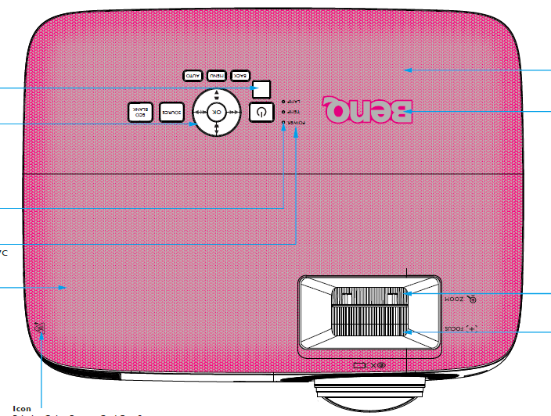
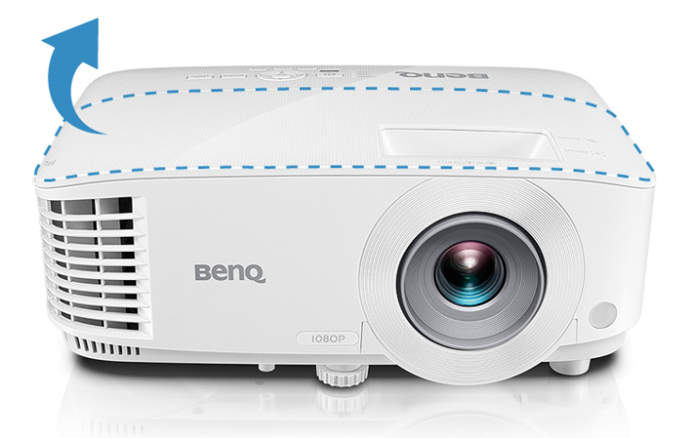
Upper Lamp Door
Upper Lamp Door for Simplified Lamp Maintenance
A quick-release lamp door provides IT managers convenient access for efficient lamp maintenance without removing the projector from ceiling-mounted installations.

