Slide 1
MS610/MX611/MW612
Sales Kit

Slide 2
STP
Segmentation
SMB Business / School
Target Audience
also seek the virtue of high brightness with good color
Positioning
High Brightness, software (App) Free Wireless Display Projector*
* QCast Mirror/QCast is optional

Slide 3
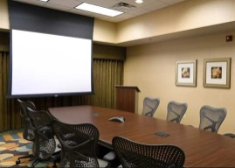
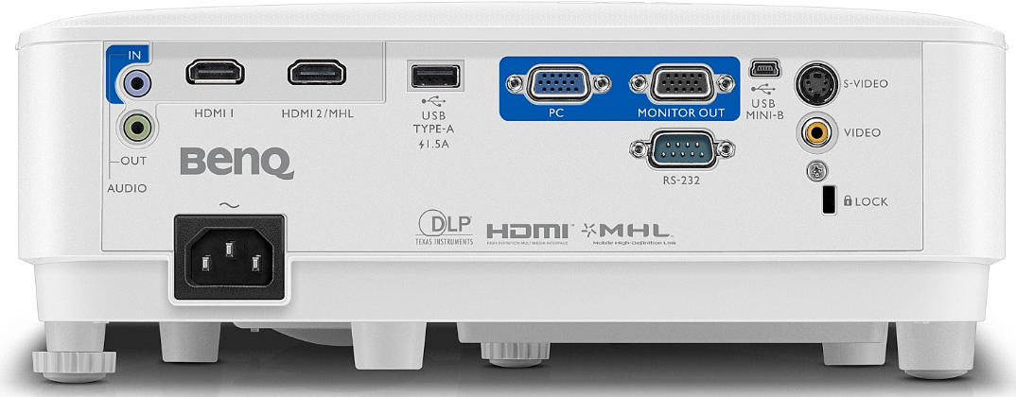
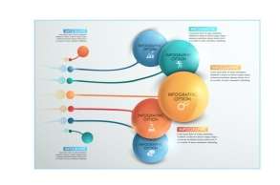

Selling point for M61
Mobile-Compatible Connectivity
Inforgraphic mode for Graphic presentation
High Brightness for SMB
TCO (Long Lamp Life: 15,000hours)

Slide 4
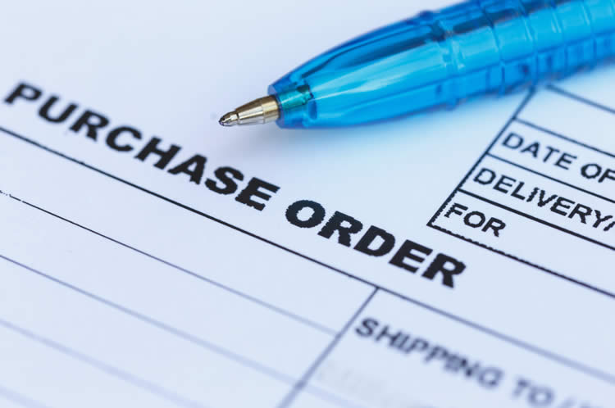
Target Buyer & User Benefit Sought
M61 series are targeting SMB/school end users who have limited budget but also seek the virtue of high brightness at sensible price points.
Procurement of SMB/School
Reliable Product
Office Workers/ Education Staff
Bright and Clear Image
Low TCO
Easy to use and adjust
Digital connection

Slide 5
Value Proposition
A wireless-compatible projector with high brightness delivering professional presentation in any midsize-to-large meeting room at a sensible price point.
Quality Presentation
High Brightness
(4000AL)
High Contrast
(15000:1)
Easy Set-up
Digital Connectivity (HDMI*2)
Zoom Ratio
(1.1X)
Low TCO
Energy-Saving (SmartEco/EcoBlank)
Long Lamp Life
Embedded Speaker
Good Color
Anti-Dust Improvement
Optional Wireless Connectivity

Slide 6
Model Nome | MS610 | MX611 | MW612
Native Resolution | SVGA (800x600) | XGA (1024x768) | WXGA (1280x800)
Brightness | 4000 ANSI lumens
Contrast Ratio | 20,000:1
Lens | F=2.56-2.68, f=22-24.1 mm
Throw Ratio | 1.96~2.15 | 1.96~2.15 | 1.55~1.7
Image Size (Diagonal) | 30"-300"
Zoom Ratio | 1.1x
Lamp Wattage | 240W
Lamp Life | Normal 4000 hr / Economic 8000 hr / SmartEco 10000 hr / LampSave 15000 hr
Keystone Adjustment | 1D, Vertical +/- 30 degrees
Projection Offset | 110%±2.5% (Full Height) | 110%±5%(Full Height) | 100%±2.5%(Full Height)
Resolution Support | Up to WUXGA (1920 x 1200) Reduced Blanking
I/O | Computer in (D-sub 15pin) x 1 (Share with component) Monitor out (D-sub 15pin) x 1 Composite Video in (RCA) x 1 S-Video in (Mini DIN 4pin) x 1 HDMI x 2(one share with MHL) MHL x 1 USB-A x 1(5V/1.5A) Audio in (Mini Jack) x 1 Audio out (Mini Jack) x 1 Speaker 2W x 1 USB (Type mini B) x1 (For FW upgrade) RS232 (DB-9pin) x1 IR Receiver x2 (Front+Top)
Dimensions (WxHxD) | 296 *120 *221 mm
Weight | 2.3kg
Power Consumption | TBD, Standby <0.5W

Slide 7
Feature Introduction

Slide 8
M6 Wireless Compatible Projector
Key Feature
Image Performance
High Brightness
Easy Set-up
Vertical Keystone
Low Maintenance Cost
Power Saving
(Smart Eco, Lamp save mode,
Eco Blank, Auto Power Off)
Sharp Contrast Ratio
3D color management
Instant Restart
Mobile
Presentation
Mobile-Compatible Connectivity
RC Hot Key
Upper Lamp Door
Optional QCast Mirror

Slide 9
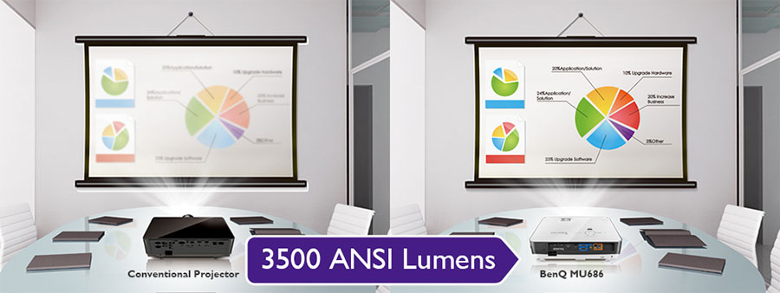
High Brightness & Sharp Contrast
Image Performance
Easy Set-up
Low Maintenance Cost
MX611/MW612 feature a high brightness up to 4000 ANSI lumens, enabling anti-interference operation under ambient light!
4000 lumens
3300

Slide 10
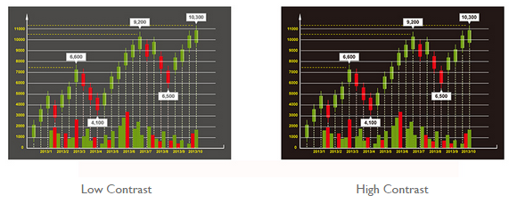
Sharp Contrast
Image Performance
Easy Set-up
Low Maintenance Cost
Mobile Presentation
A high contrast ratio ensures that every text, image, graph, chart and video is projected with optimal clarity and enhanced sharpness, especially for numerical data. This is for presenters to view their presentation files clearly and the audience to stay focused on the contents projected.

Slide 11
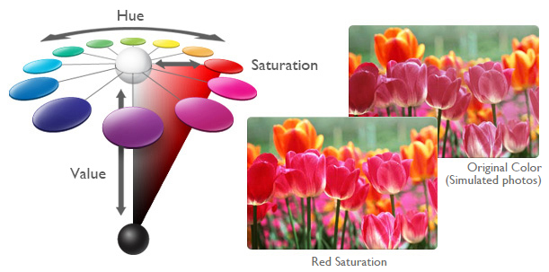
3D color management
Image Performance
Easy Set-up
Low Maintenance Cost
Mobile Presentation
Independent 3D Color Management for Six Primary Colors
BenQ’s exclusive 3D color management tool ensures 100% uncompromised color customization with the freedom to independently fine-tune the hue, grain and saturation levels of all six primary colors (R/G/B/C/M/Y).

Slide 12

Image Performance
Easy Set-up
Low Maintenance Cost
Mobile Presentation
Vertical Keystone
When the projector is placed off center, the automatic keystone correction feature gives you a wider projector installation flexibility by correcting the trapezoid effect using vertical adjustment automatically.

Slide 13
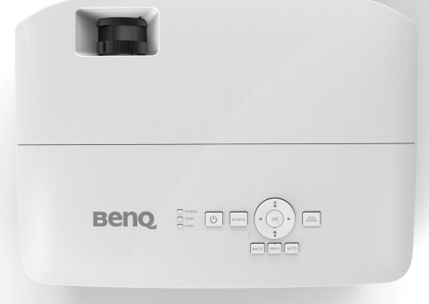
Image Performance
Easy Set-up
Low Maintenance Cost
Mobile Presentation
Instant Restart
When users turn off the projectors, the projector will maintain at 30% of power during the 90 seconds. If users turn on the projector within 90seconds, the projector will start immediately.
Within
90 seconds
Turn off the projector
The projector will be turned on immediately

Slide 14
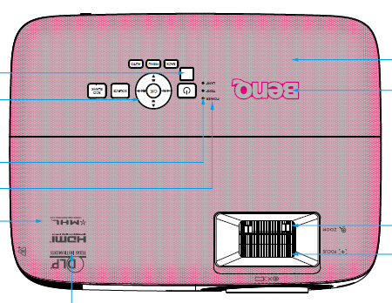
Image Performance
Easy Set-up
Low Maintenance Cost
Mobile Presentation
Upper Lamp Door
On-the-top lamp door for easy access and maintenance
It is very easy to access and replace lamp when the projector is either mounted on the classroom ceiling or placing on the desktop.

Slide 15

Image Performance
Easy Set-up
Low Maintenance Cost
Mobile Presentation
Smart Eco
Full Brightness
Dynamic Power Saving
Long Lamp Life
SmartEco mode helps to save up to 70% lamp power consumption depending on the
content brightness level and keeps the image as bright as it is in normal mode.
No more compromise between image quality and power consumption!

Slide 16


Image Performance
Easy Set-up
Low Maintenance Cost
Mobile Presentation
Lamp Save Mode
Projector lamp replacement costs make up the biggest part of the total cost of projector ownership. The LampSave Mode is designed to adjust the lamp power dynamically by content brightness level to extend projector lamp life significantly by 50%! The lamp replacement frequency is also reduced by up to 50% to lower the replacement costs.
15,000
Maximum
Lamp life

Slide 17
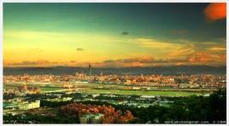
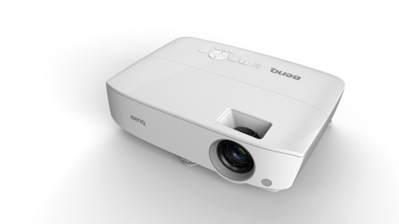
Image Performance
Easy Set-up
Low Maintenance Cost
Eco Blank
Blank the screen and saves lamp power by up to 70% when the projector is not actively in use
Press “Eco Blank” button on the remote control or keypad to draw attention from audience.
Eco Blank
Save up your lamp power
Time to do your part in saving the planet

Slide 18
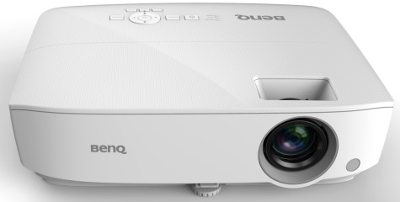
Image Performance
Easy Set-up
Low Maintenance Cost
Mobile Presentation
Auto Power Off
After 20 minutes of not actively used, the projector will turn off automatically to save the power consumption and protect itself from forgetting to be turned off.
This function could be adjusted in OSD.
Operating
Turned Off
20 minutes

Slide 19
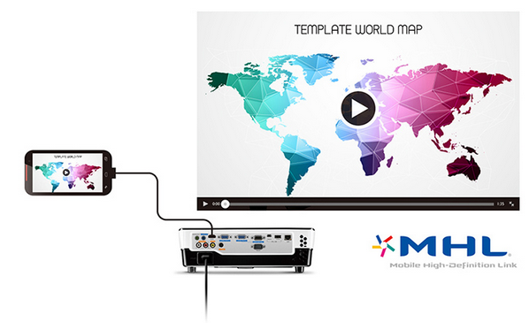
Image Performance
Easy Set-up
Low Maintenance Cost
Mobile Presentation
Mobile-Compatible Connectivity
MHL supported
With MHL, you can present your business proposals and share your ideas instantly using your Android smart device. Turn small screen into big screen by mirroring documents, photos, videos and any other content in your smart device onto the projection screen. Once connected to the projector, the smart device will be electrically charged so you don’t run out of battery power while presenting.

Slide 20
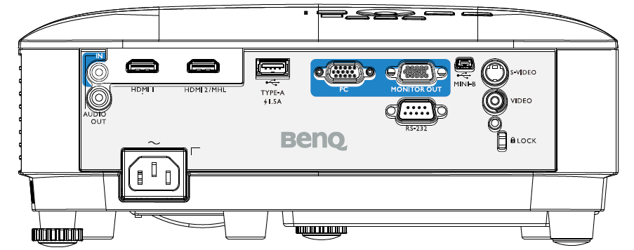
Image Performance
Easy Set-up
Low Maintenance Cost
Mobile Presentation
Mobile-Compatible Connectivity
5V/1.5A USB Power
Provide steady 5V/1.5A DC to power any wireless dongle, giving a high quality wireless presentation experience in meeting room.

Slide 21
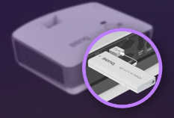
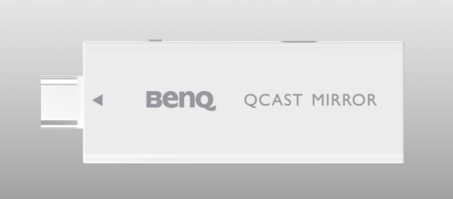
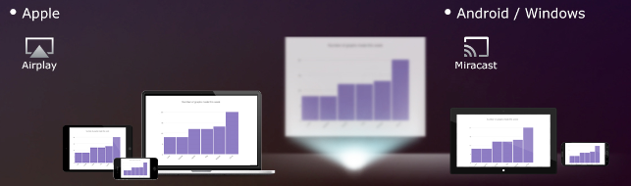
Image Performance
Easy Set-up
Low Maintenance Cost
Mobile Presentation
QCast Mirror (Optional Wireless Dongle)
Mirror Screen
Easy Setup with HDMI and USB power. And then simply operation with Airplay/Miracast from mobile devices (Tablet/Smart Phone/ Notebook) makes your small display to large screen.
2.4G/5G Dual Band WiFi
5G WiFi bandwith is compatible with the latest mobile technology and brings a better transmission performance.
OTA(Over-the-air) Update
This allows a to go into Settings to download and install the latest firmware on-device wirelessly.

