Slide 1
TH671ST
Product Brief
BenQ Corporation

Slide 2
Specification

Slide 3
Specification
Model | TH671ST
Brightness | 3000 lm
Contrast ratio | 10000:1
Color wheel | RGBYCW
Resolution | 1920 x 1080
Lamp life | Normal 4500 hours / Economic 10000 hours / SmartEco 10000 hours/ LampSave 15000 hours
Lens | F = 2.6 ~ 2.78, f = 10.2 ~ 12.24mm
Throw-ratio | 0.69 ~ 0.83 (100" @ 1.5 m)
Offset | 102.5% ± 2.5%
I/O | PC x1 Monitor Out x1 HDMI x2 MHL x1 (share w/ HDMI1) | USB Type A x1 (1.0A supply) USB Type-mini B x1 Audio in x1 Audio out x1 | RS232 x1 5W Speaker x1
Noise | 33 / 29 dB
Feature | Low Input Lag LumiExpert Short Throw

Slide 4
Features Introduction

Slide 5
Features
Low Input Lag
You will feel the motion control is delayed when playing racing, sports and FPS games.
BenQ gaming projector has the lowest input lag,16ms (1 frame).
Low Input Lag: Off
Low Input Lag: On
Notes:
http://www.projectorcentral.com/projector-input-lag.htm

Slide 6
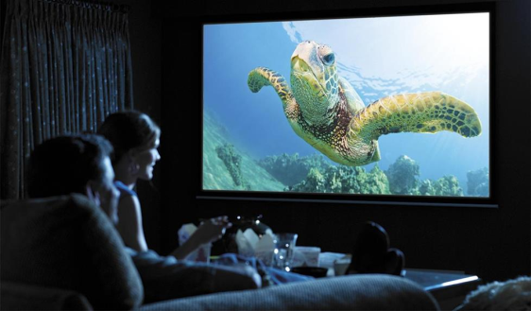
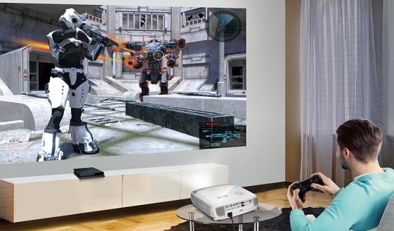
Features
LumiExpert
Saving efforts to optimize brightness basing on the actual ambient light.
Giving a comfortable viewing experience.
Being more flexible to have a indoor big screen projection.
Notes:
Smart Picture Mode除了能減少使用者在調整畫面亮暗的不便，BenQ最佳化的亮度調整也能讓使用者有更好的視覺體驗。
Smart Picture could save efforts to optimize brightness performance and give a comfortable viewing experience.
同時，使用者就不需受限空間的亮度限制，能在家中的亮暗環境使用。
Moreover, users have no limitation to use projector in the house with different ambient light.

Slide 7
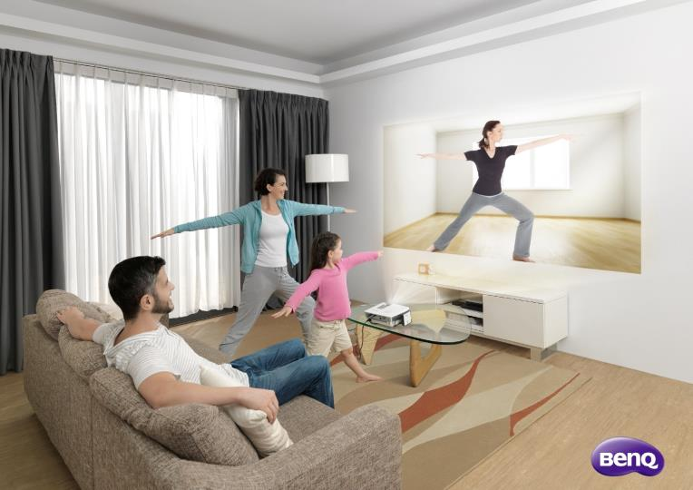
Features
Short Throw
Short-throw design can save efforts to have a big screen projection inn a small room.
TH671ST can have 100 inched screen at 1.5m.
100”
1.5m

Slide 8
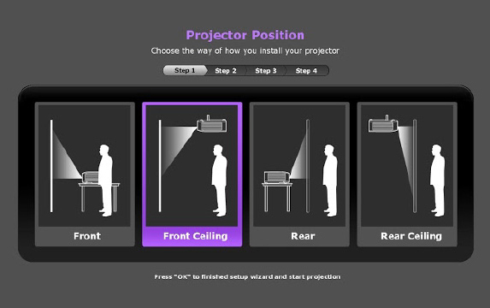
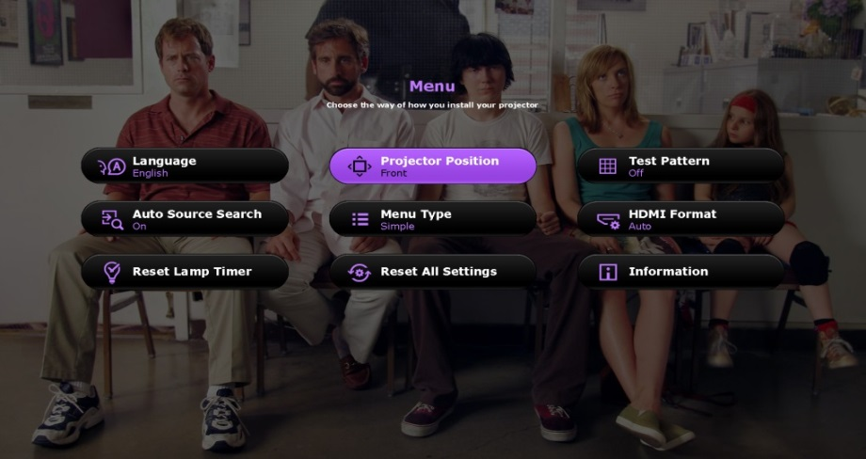
Features
Setup Assistant
Follow the friendly setup wizard to step-by-step setup your big screen projection.
With basic menu, users can access the common setting in seconds.
With advanced menu, users can have a detailed setting for the further needs.
Setup Wizard
Basic Menu
Notes:
1080P (P.6) by RO

Slide 9
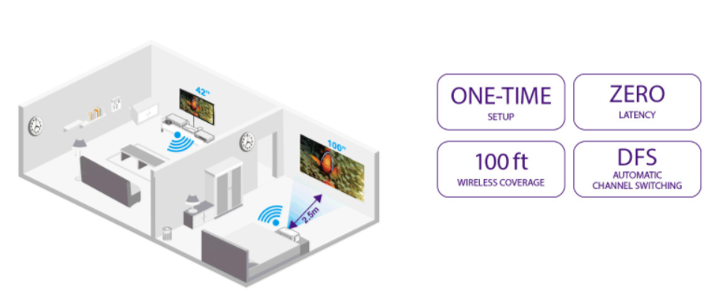
Features
Optional Wireless Kits
One –stop home entertainment without wires. Enjoy you favorites everywhere in your house
Notes:
1080P (P.6) by RO

Slide 10
Features
More Power Saving, More Eco Friendly
Innovative technology for the Lamp life for much lower cost and much more care to the environment. It can achieve 15,000 hours while in LampSave mode.
15,000Hrs
Notes:
1080P (P.6) by RO

Slide 11
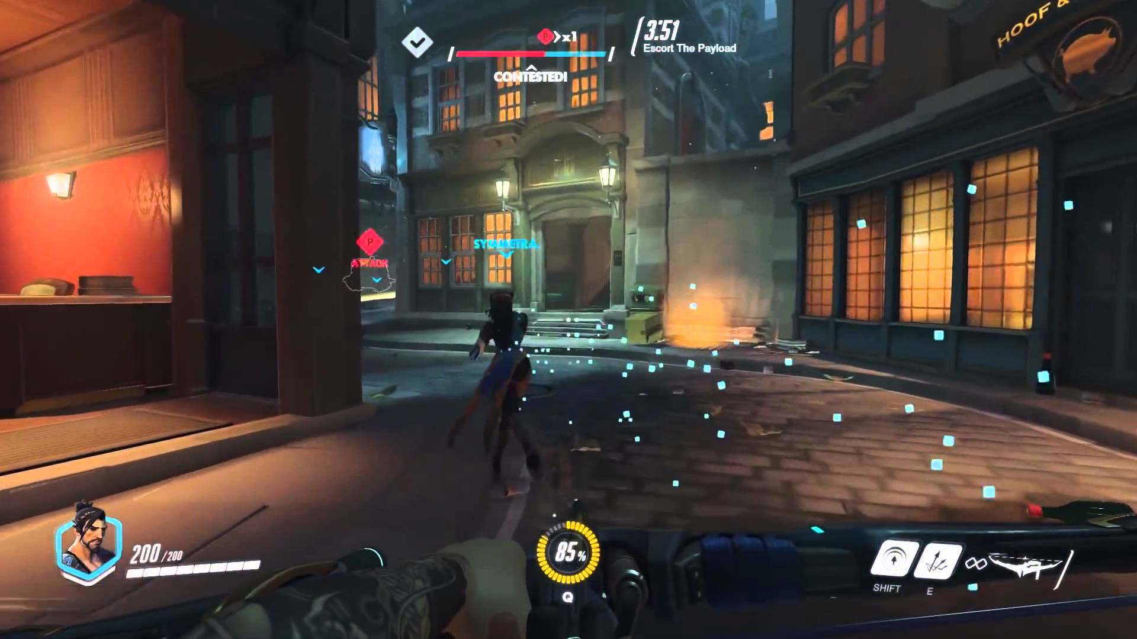
Features
Born for Home Entertainment
Sport, Vivid TV and Cinema picture mode provide the best visual experience
In different contents.
Sport Mode
Vivid TV Mode
Cinema Mode
Game Mode
Notes:
1080P (P.6) by RO

Slide 12
TH671ST vs. BenQ W1210ST
BenQ W1210ST/HT2150ST | POP | BenQ TH671ST
Optical | Optical | Optical
2200lm 15000:1 RGBRGB C/W | TR 0.69~0.83 (100”@1.5m) 1.2x Zoom 102.5% ± 2.5% Offset | 3000 lm 10000:1 RGBYCW C/W
Interface | Interface | Interface
12V Trigger x1 10W Chamber Speaker x2 | VGA D-sub x1 HDMI x2 MHL x1 USB Type A x1 USB Type mini B x1 Audio In x1 Audio out x1 RS232 x1 | Monitor Out x1 5W Chamber Speaker x1
Features | Features | Features
Carry Bag CinemaMaster Audio+ | Low Input Lag (16.7ms) Setup Wizard Optional Wireless Kits | LumiExpert
Better C/R
Better Color
Affordable
Price
Better Speakers
Carry Bag
CinemaMasrt
Audio +
LumiExpert
Notes:
http://www.acer.com/ac/zh/TW/content/predator-z650-series
http://www.projection-homecinema.fr/2015/12/26/test-acer-z650-predator/

