Slide 1
MX842UST/MW843UST
Sales kit
BenQ Taipei Product Center

Slide 2
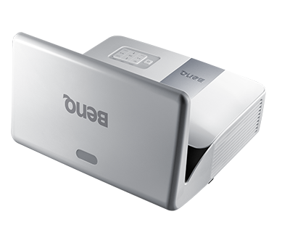

MX842UST/MW843UST
3000AL high brightness
Mirror type Ultra short throw
7000 long lamp life
Easy installation Wall mount bundle and slide in design.
SmartEco eco cycle system . SmartEco mode/ Eco blank and auto power off
LAN control Best solution for school IT Manager for monitoring.
Various 3D format

Slide 3
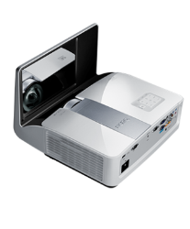
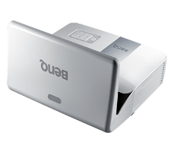
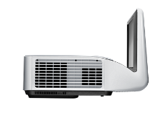
Value Proposition and Product Feature
Performance | Low TCO | User friendly
UST throw distance | SmartEco Power Saving | Wall mount bundled
3,000AL brightness | Eco Blank | Installation chart
16:10 Wide range resolution | LAN control management | Upper lamp door
Low 30dBA noise | Auto Power Off
13,000:1 High contrast ratio.

Slide 4
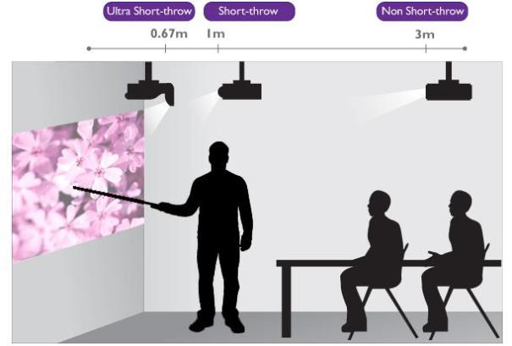
Performance - Shorter distance, Less shadow
0.4 ST
80” @ >0.5m
0.6 ST
80” @ 1m
Non-ST
100” @ 3m
Benefits
Teachers’ vision will not be affected by the projection light, creating a better teaching experience.
Projected image will not blocked by teacher and thus students’ viewing experience is improved.

Slide 5
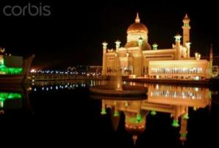
Performance - Clear and Beautiful Image
High Contrast
Low Contrast
Benefits
3,000 ANSI Lumens of Brightness renders a clear image in a classroom/meeting room with accurate color.
High contrast ratio of 13,000:1 provides a vivid color performance and dramatic improvement in black level.

Slide 6






Low TCO – LAN Control
Class room
Benefits
Multi-Projector monitoring and controlling is supported through LAN system.
The LAN terminal is compatible with PJLink and Crestron, both are open protocols used by many manufacturers.
Lecture room
LAN
Meeting room
Auditorium

Slide 7
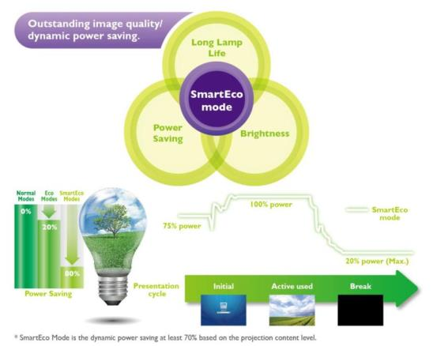

Low TCO - SmartEco
Benefits
SmartEco
No compromise between image quality and power consumption.
Saving up to 80% of energy.
Auto Eco Blank
Eco Blank Mode is auto active when no signal for 3 mins.
Auto Power Off
Auto power off when projector is not using for 30 mins.

Slide 8
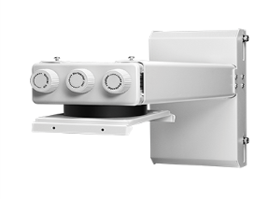
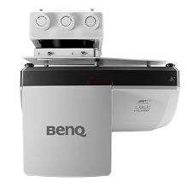
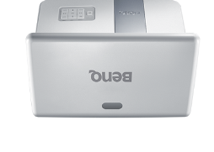
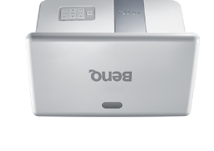
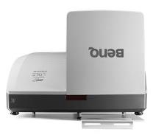
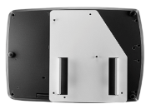
User-friendly – Wall Mount
Vertical tilt/Horizontal roll/Horizontal rotation
Easy Slide in
Benefits
Wall mount comes with every Ultra-short throw projector.
Wall mount plate is pre-assembled with projector for easy installation.
3-Dimenions effortless adjustments
Horizontal shift Max to 3cm
Vertical shift Max to 4cm

Slide 9
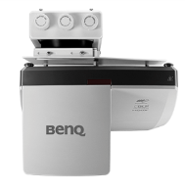

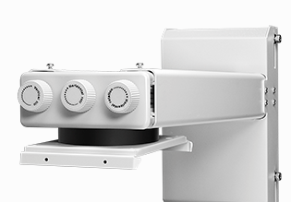
Vertical tilt/horizontal roll/horizontal rotation
3CM horizontal adjustment

Slide 10

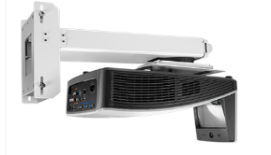
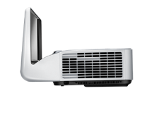
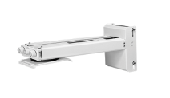
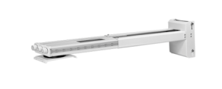
User-friendly – Installation Chart
40mm
Vertical offset adjustment.
Benefits
Installation chart is designed for locating wall mount position
Easy-steps to perfect installation
Place the chart on the wall
Select the image size and find the upper line of screen.
Mount the screen
Mount the wall plate
Mount the wall mount
Adjust the ruler on the side to meet desired image size. (70”-105”)

