Slide 1
SV500 sales kit
BenQ Digital Signage
2014.01.17

Slide 2
Value Digital Signage Concept:
LED panel & solution
+
Signage function value-added
Good lifespan
400nits brightness
Various input/output sources
Support both Landscape & Portrait
Remotely control multiple displays (MDA)
Daisy chain for video wall application

Slide 3
SV500 Key Features
10.4mm slim bezel
Landscape/ Portrait Display
Built-in Media Player
Daisy Chain
MDA
Remotely Control w/ Failure Alert System
Higher Reliability in Portrait Mode
Up to 2x2 without splitter
Built-in Easy Media Play

Slide 4

Slime Bezel Design : 10.4mm
Economical way to implement Video wall solution
Slim Bezel boarder: 10.4mm
SS 46’’:17.4mm (up/left/right); 20.8mm (down)

Slide 5
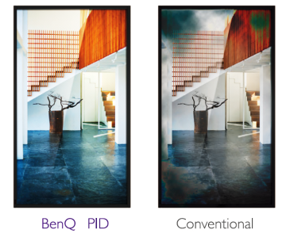
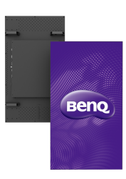
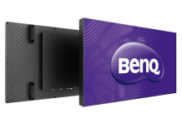
Industrial Grade Panel
The panel employs a structure featuring more solid fixing points on all edges to prevent “MURA” image distortion common on vertically positioned consumer displays.
MURA happened
Landscape mode
Portrait mode

Slide 6
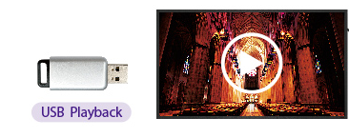
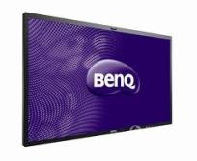

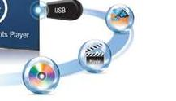
USB Plug and Play
The simplest and economical way to distribute content
Play the multi-media files saved in USB devices directly by simply plug-in
‧USB Playback
‧Supporting Format
Image: JPEG, BMP
Audio: MP1/2/3, WMA, OGG, WAV, AAC
Video: .avi .divx .mkv, .ts, .dat, .vob, .mpg, .mpeg, .mov, .mp4, .rm, .rmvb, .wmv
Docs: PDF, MS Word/Excel/Power Point
*Format supported: image, audio, video and MS office

Slide 7

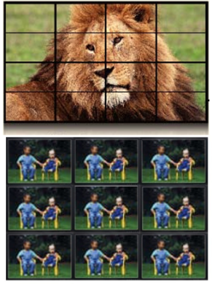

Digital Daisy Chain
Supports the array configuration of up to 10X10 displays in OSD setting
DVI-in
DVI-out
DVI-out
DVI-in
2X2 DVI daisy chain no splitter needed.
2X2 VGA daisy chain no splitter needed.
Notes:
Resolution? FHD?

Slide 8
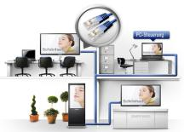
Control Multiple Display with Ease
BenQ
MDA
BenQ Multiple Display Administrator (MDA) is a management application to control multiple display simultaneously and remotely via LAN & RS232
Remote admin
  unlimited controllable via Lan,
  up to 98pcs by RS232
  Scheduling Setup remotely
  Clone function
Diagnostic /Error detection (Voltage/Temp.)
Monitors the real-time temperature & voltage of display
Automatic E-mail alert
Sends e-mail to alert abnormal real-
time temperature & voltage of
display
4. Startup delayer for video-wall
Optimizes video-wall startup process to avoid the damage from unstable voltage supply

Slide 9
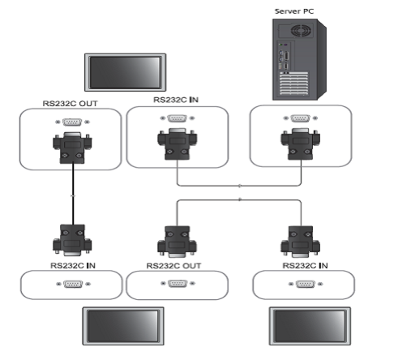
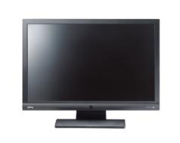
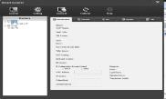

Functionality – MDA Software
BenQ Multiple Display Administrator
This useful system providing users:
The simplest way of monitoring/maintaining the PIDs (clone functions)
The remote control availability (control the PIDs being setting up distant from central control)
Time saving = $ saving
Display 1
Remote command & setting
Display 2
Display 3

Slide 10
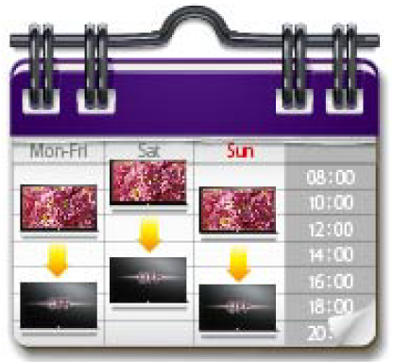
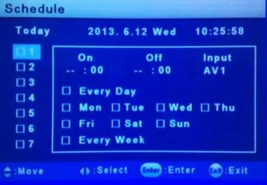
Scheduling
Use the scheduling function to designate up to 7 sets of on/off time for displays down to individual video input sources.
To save time and management efforts as well as energy consumptions
Selecting on/off time
Selecting Input source
Up to 7 different settings
Selecting date

Slide 11
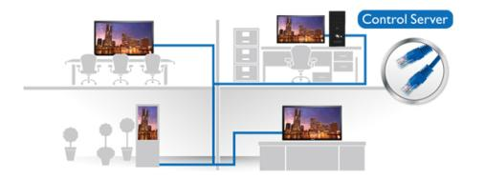
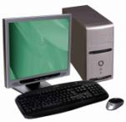
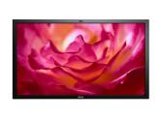
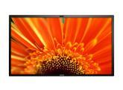
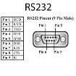
Connectivity
LAN/RS232 control
Control remotely – Control OSD setting and FW update
Multiple displays can be controlled via daisy chain by RS232/LAN
Control and FW update by remote PC
Multiple displays can be controlled via daisy chain by RS232/LAN

Slide 12
SV500 Spec
 |  | SV500
Panel | Size | 50’’
 | Back Light | LED
 | Panel type | Direct LED
 | Resolution | 1920x1080 FHD
 | Viewing mode | Landscape & Portrait
 | Viewing angle | 178 degree (H) / (V)
 | Response time | 8ms
 | Frame rate | 60Hz
 | Life span | 30,000 hrs
 | Luminance | 400nits
 | Contrast ration | 3000:1
Audio | Internal Speaker | 10Wx2
I/O | Input sources | VGA/DVI/HDMIx2/Audio/USB
 | Output sources | VGA/DVI
Special features | Self-video wall | VGA 2 x 2/DVI 2 x 2
 | S/W | MDA
Control | Input source | RS232/LAN RJ45
Mechanical | Bezel Width | 10.4mm

